Slide 1

R | Basic Text Analysis
Presented by Aviv Lo

Slide 2




Table of Contents
Topic 2
Topic 4
AI/ML/NLP Explained
Data Gathering & Extraction
Topic 1
Topic 3
R vs. Python
Text Analysis

Slide 3
1
R vs. Python

Slide 4

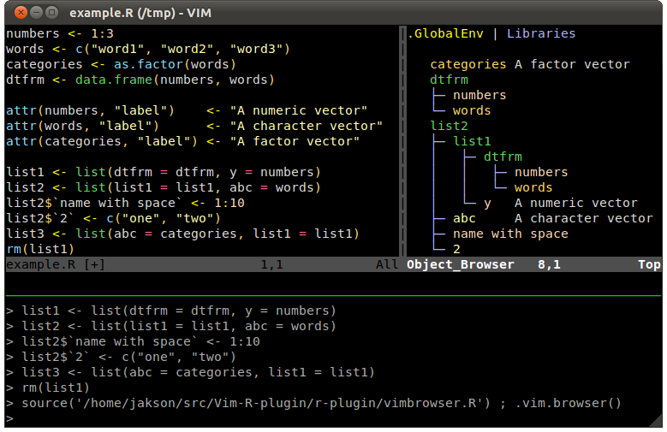
Developed by Ross Ihaka and Robert Gentleman in 1993
Hence the name “R”
Maintained by The R Foundation for Statistical Computing
Difficult for beginners + Steep learning curve
Rich and powerful visualization libraries
Support matrix / vectorized operations
It’s born for stats
Notes:
http://manuals.bioinformatics.ucr.edu/home/programming-in-r

Slide 5

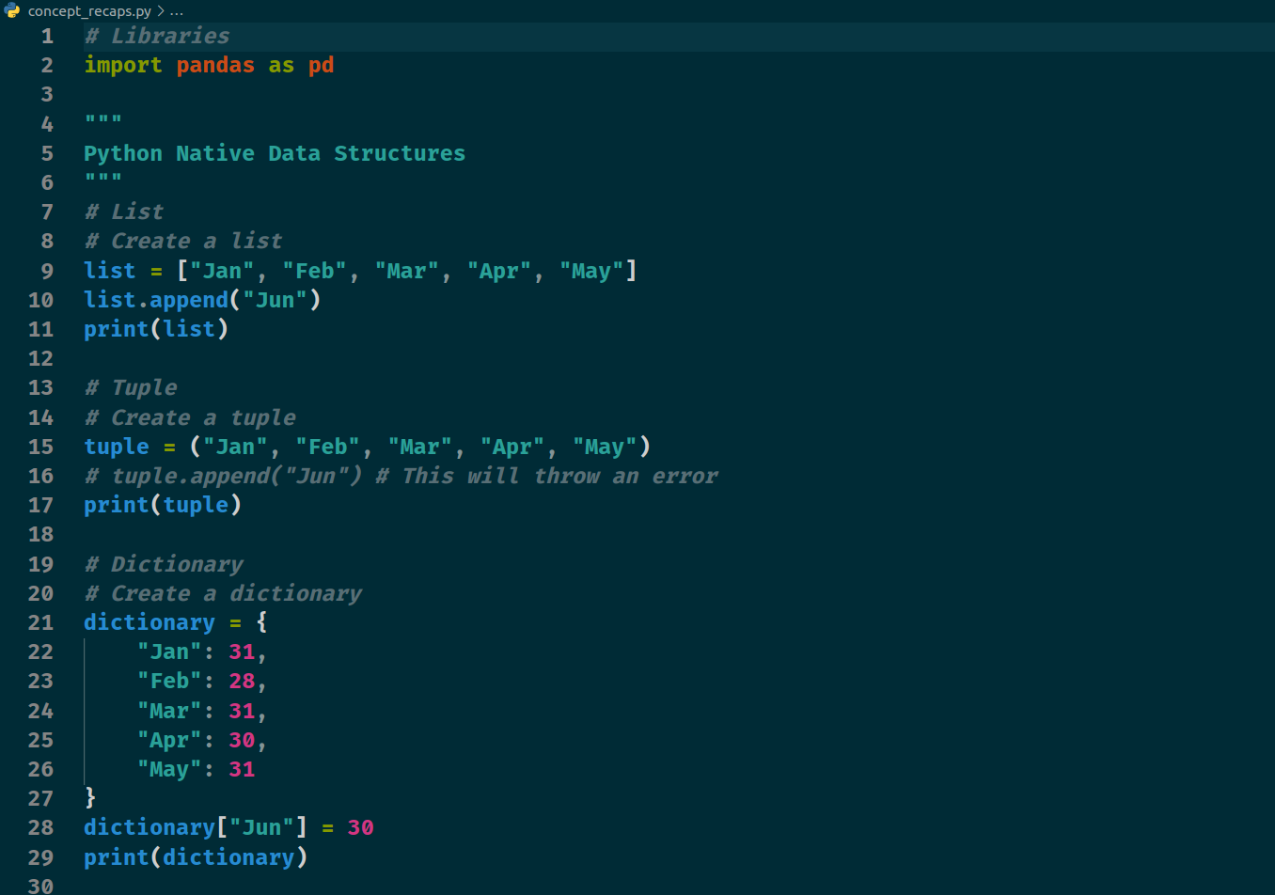
Developed by Guido van Rossum in 1991
Naming was inspired by Monty Python
Successor to the ABC language
Maintained by the Python Software Foundation
Easy for beginners + Smooth learning curve
Good libraries for creating graphs
Support matrix / vectorized operations via external libs
Notes:
http://manuals.bioinformatics.ucr.edu/home/programming-in-r

Slide 6
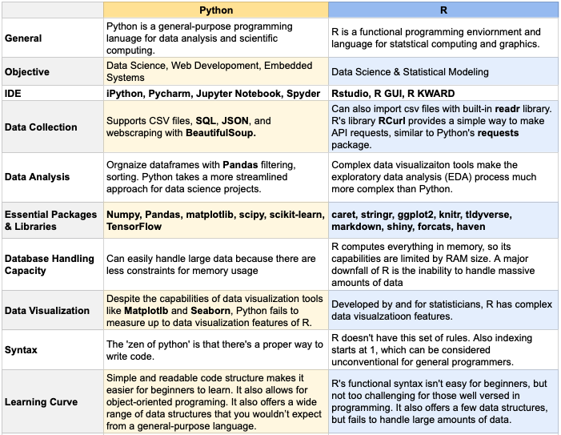
R vs. Python
Notes:
https://towardsdatascience.com/python-vs-r-the-basics-d754c45c1596

Slide 7
2
AI/ML/NLP Explained

Slide 8
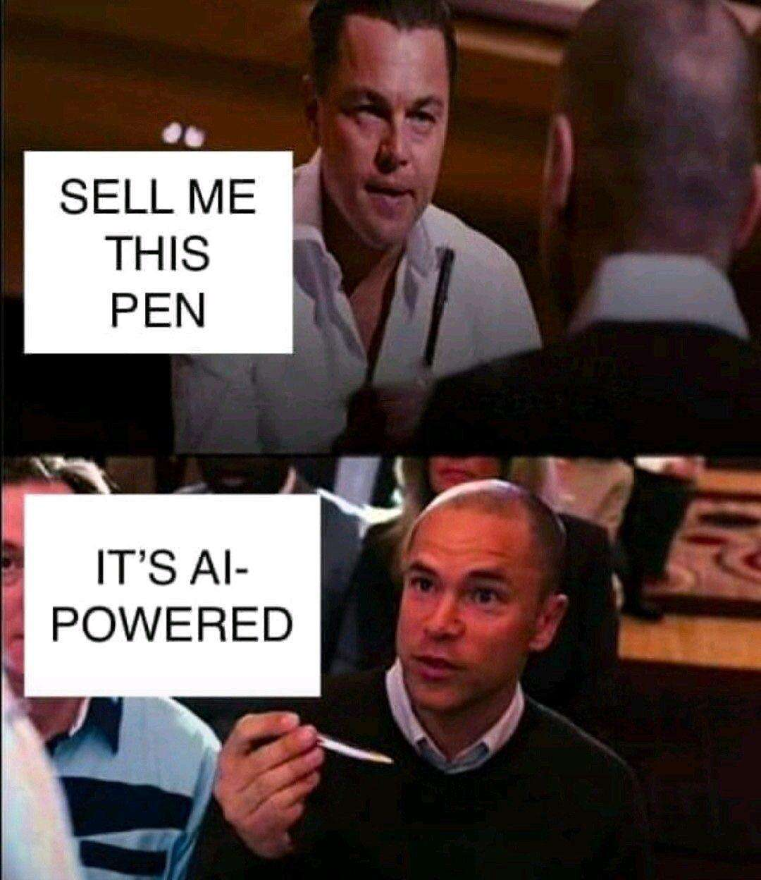
AI?
Notes:
https://datacenterfrontier.com/natural-language-processing-how-this-technique-can-take-your-business-to-the-next-level/

Slide 9
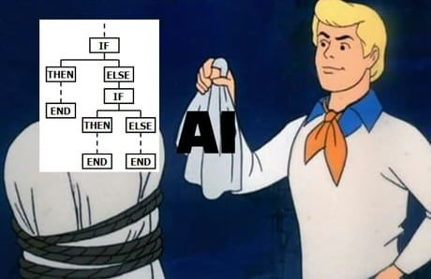
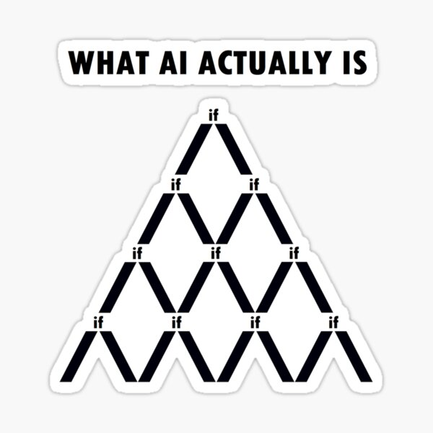
Artificial Intelligence
JOKE
Not Entirely True
Notes:
https://datacenterfrontier.com/natural-language-processing-how-this-technique-can-take-your-business-to-the-next-level/

Slide 10
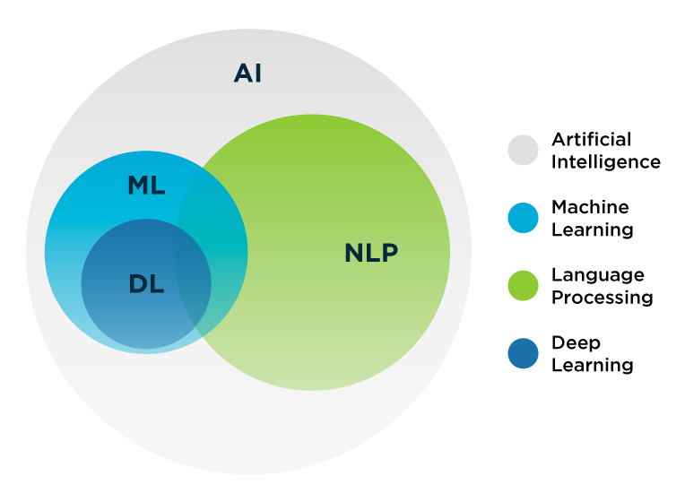
AI Domains
Notes:
https://datacenterfrontier.com/natural-language-processing-how-this-technique-can-take-your-business-to-the-next-level/

Slide 11
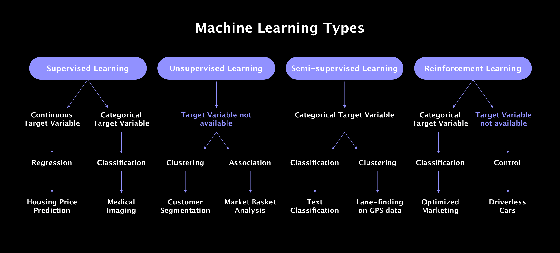
Machine Learning Family Tree
Notes:
https://litslink.com/blog/an-introduction-to-machine-learning-algorithms.

Slide 12

Machine Learning Family Tree
Notes:
https://www.isaziconsulting.co.za/machinelearning.html

Slide 13
Deep Learning: Fundamental Architecture
Feature / Architecture | ANN/MLP | RNN | CNN | Transformer
What is it? | Basic neural network | Neural network with “memory” | Neural network for grid-like data | Neural network with self-attention mechanism
Advantages | Typically easier to train | Captures sequential information and preserves dependency | Captures spatial features and relationships | Captures long-range dependencies. Parallel processing of sequences.
Challenges | Overfit easily even in simple networks | “Error” amplification (gradual or exponential) | Requires large amount of data | Requires large amount of data / very computationally intensive
Typical Use | Classification Non-linear regressions | Time series Texts and audios | Image Recognition Video Processing | LLMs & Generative AIs
Notes:
https://www.isaziconsulting.co.za/machinelearning.html

Slide 14
Recent Example: ChatGPT
Version | Parameters Count | Dataset
GPT-1 | 0.12 Billion | BookCorpus
GPT-2 | 1.5 Billion | WebText
GPT-3 | 175 Billion | CommonCrawl, WebText, English Wikipedia, Books 1 and Books 2 Corpora
GPT-4 | 1.76 Trillion | All of the above + YouTube + Twitter + Textbooks (fine tuned by Scale AI)
Notes:
https://www.kdnuggets.com/2018/10/main-approaches-natural-language-processing-tasks.html
Information extraction
Sentiment analysis

Slide 15

Tech Steamroller
Notes:
https://www.kdnuggets.com/2018/10/main-approaches-natural-language-processing-tasks.html
Information extraction
Sentiment analysis

Slide 16
3
Text Analysis
Notes:
https://www.cxtoday.com/analytics/text-analytics-vs-text-mining/
https://www.excelr.com/text-mining-vs-text-analytics

Slide 17
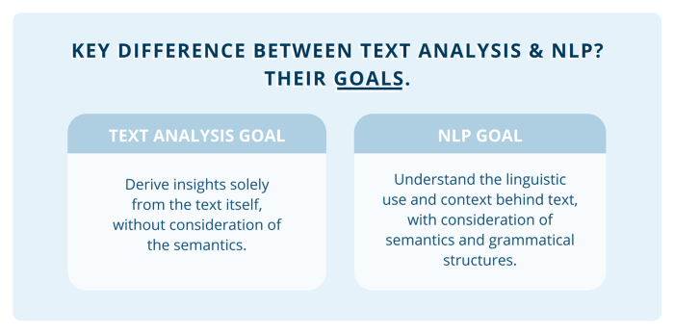
Goals
Notes:
https://towardsdatascience.com/a-guide-text-analysis-text-analytics-text-mining-f62df7b78747

Slide 18
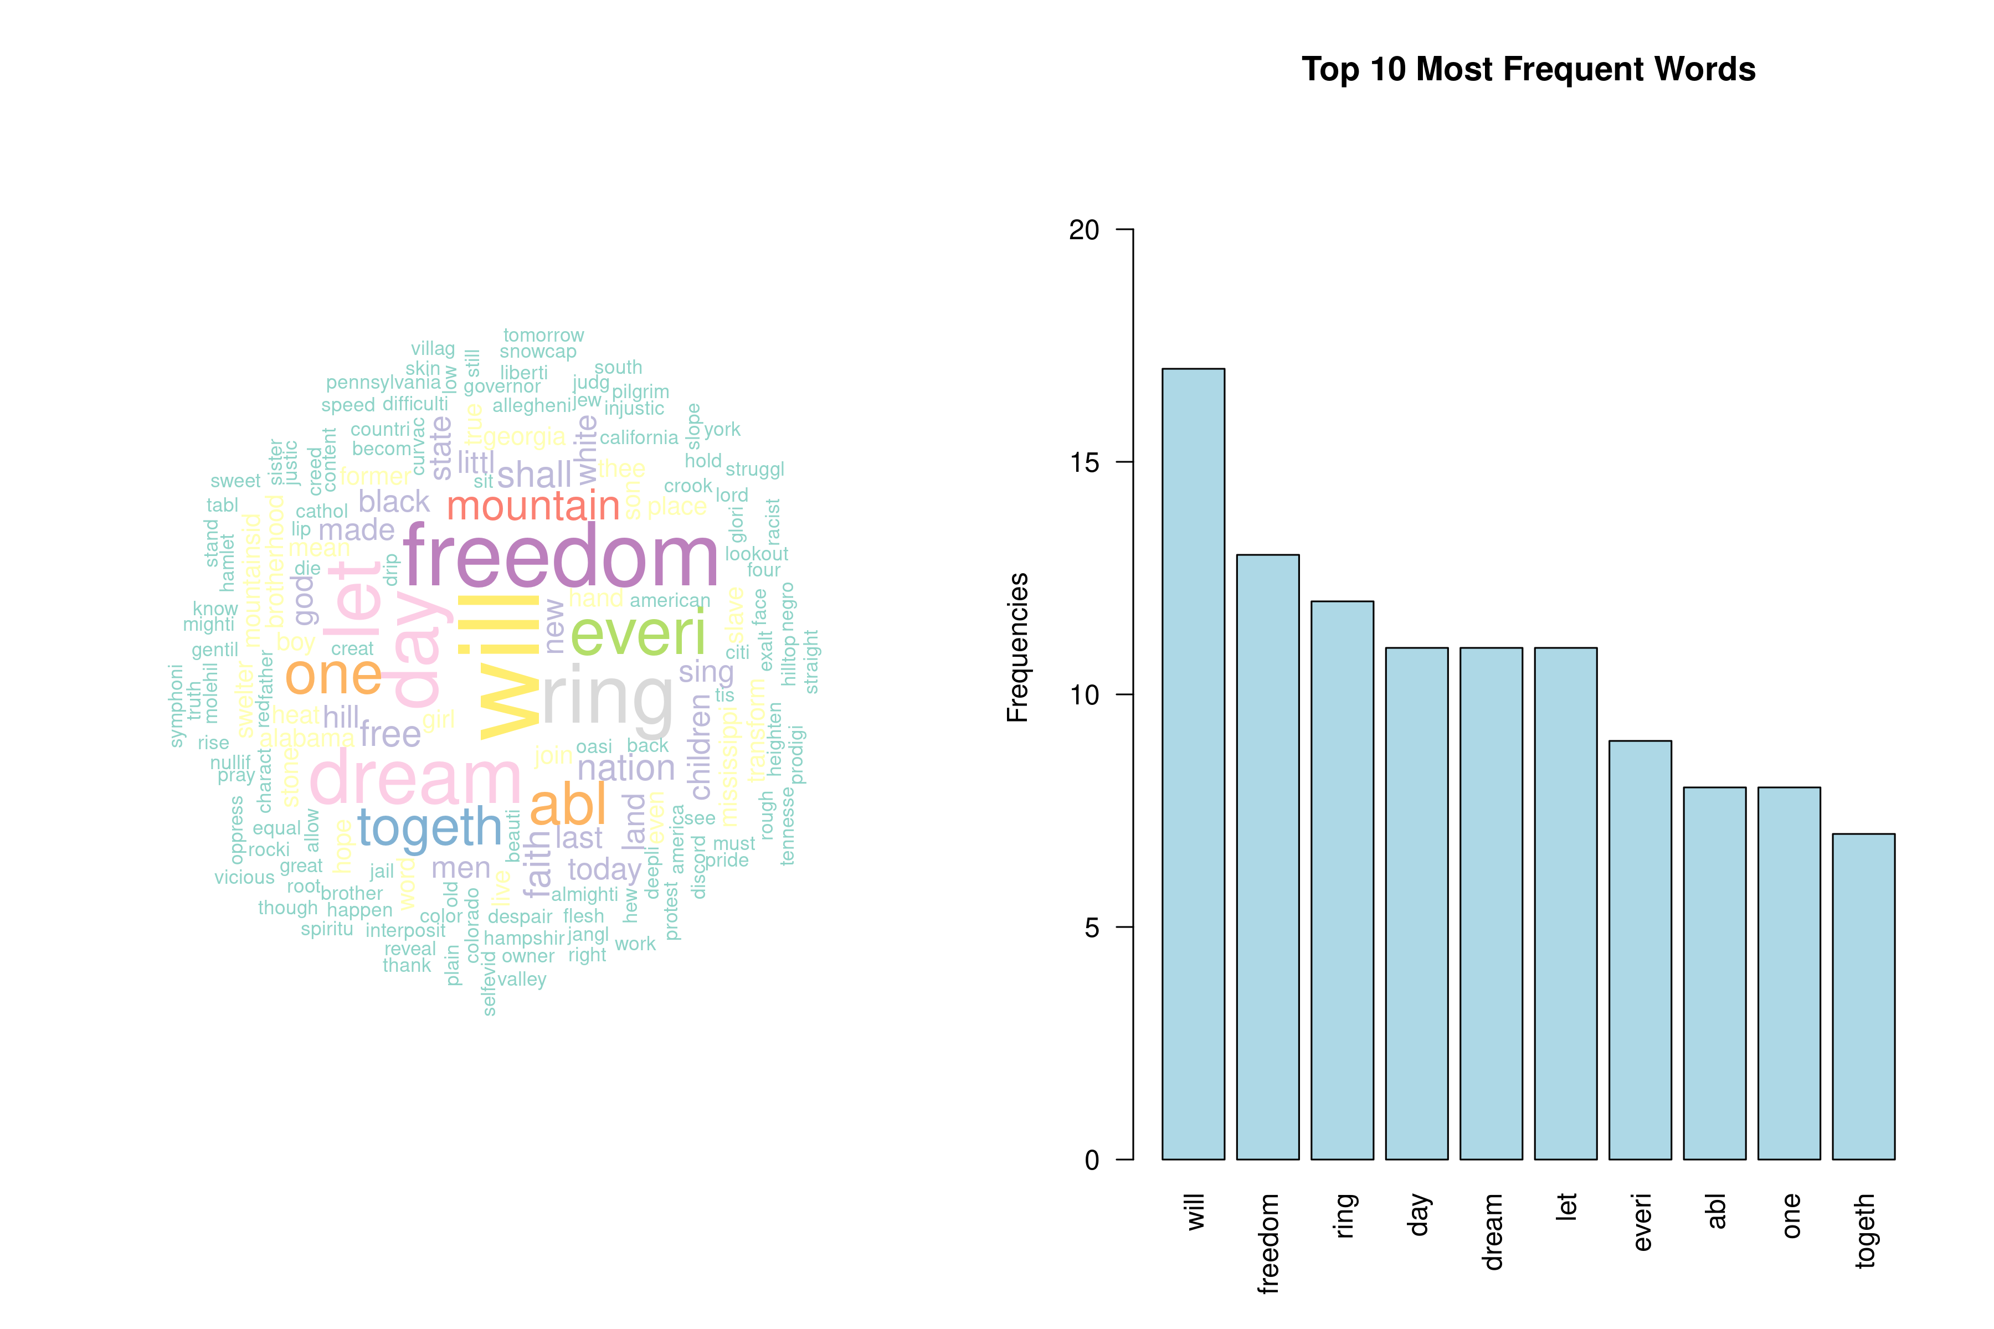
Example: Word Cloud & Word Frequency

Slide 19
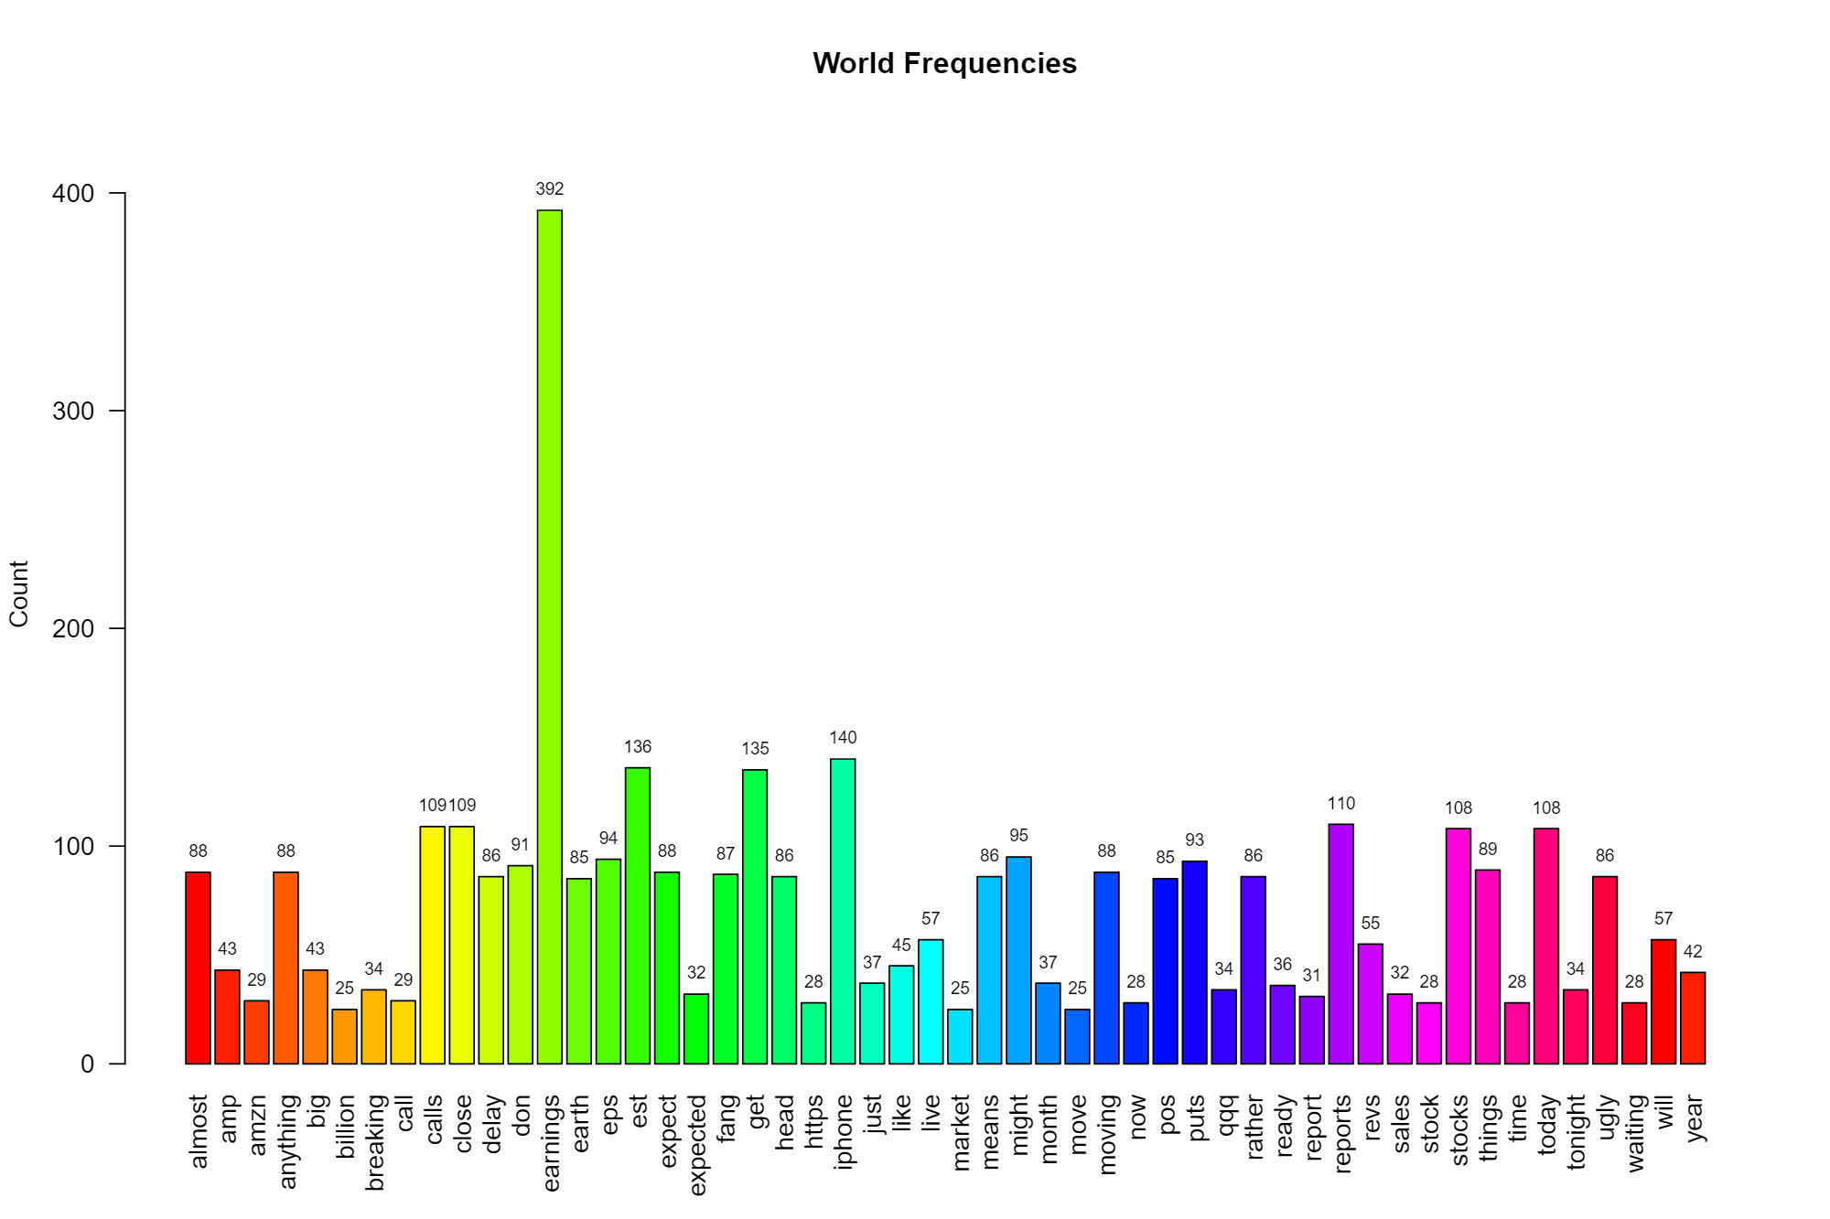
Example: Word Frequency

Slide 20
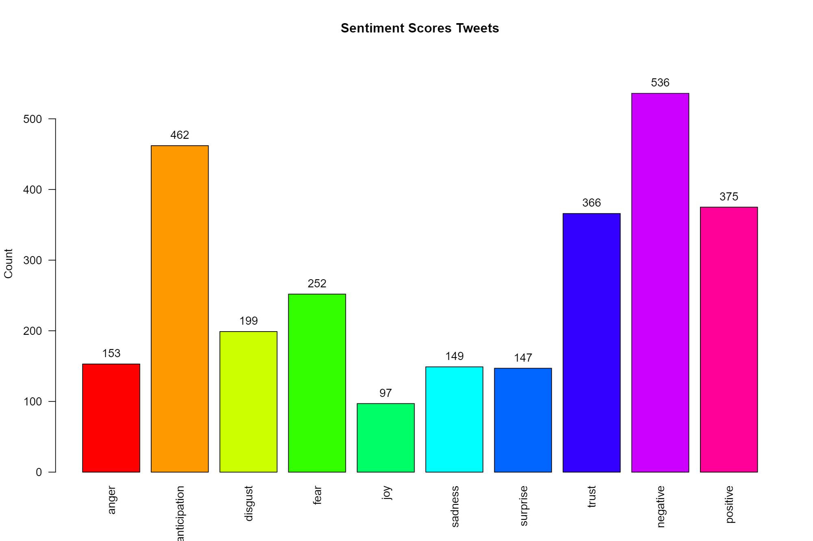
Example: Tweet Sentiment

Slide 21
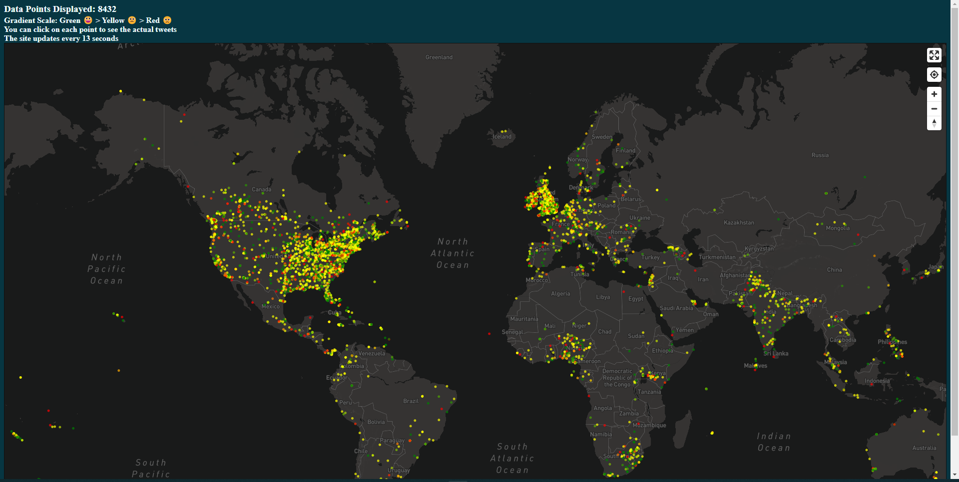
Examples: Covid Sentiment Map
Notes:
https://moodli.org/

Slide 22
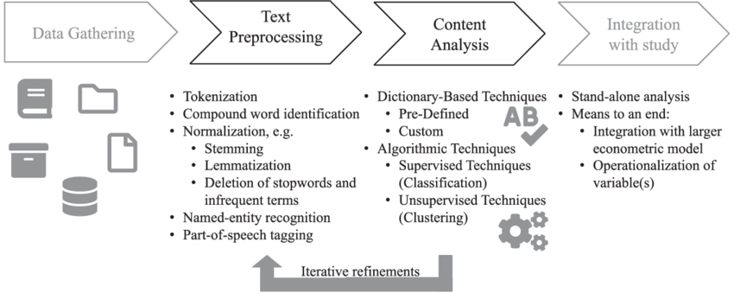
Process & Techniques
Notes:
https://www.researchgate.net/figure/Text-mining-process-and-techniques_fig1_340830772
Apply for spelling-based languages

Slide 23
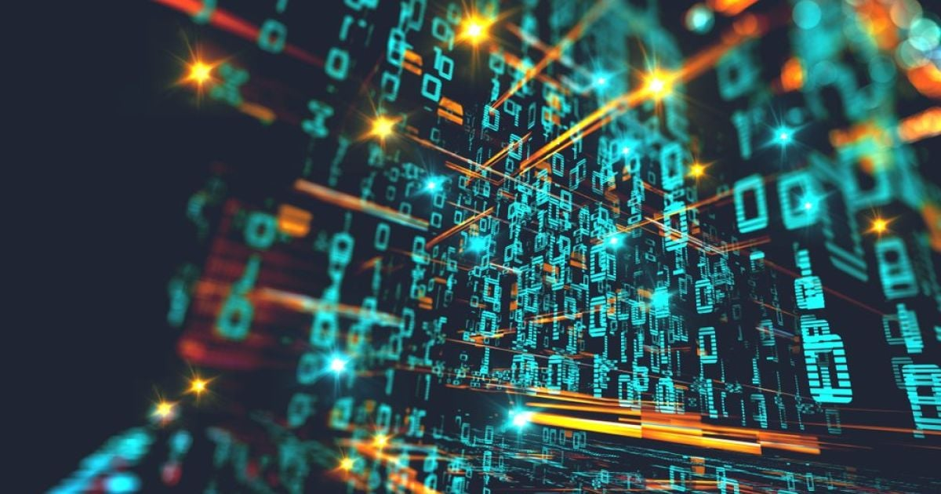
Data Gathering and Extraction
Google Dataset Search
Kaggle
GitHub
Government Sources
The World Wide Web (scraping)
Notes:
http://manuals.bioinformatics.ucr.edu/home/programming-in-r

Slide 24
4
Data Gathering &
Extraction

Slide 25
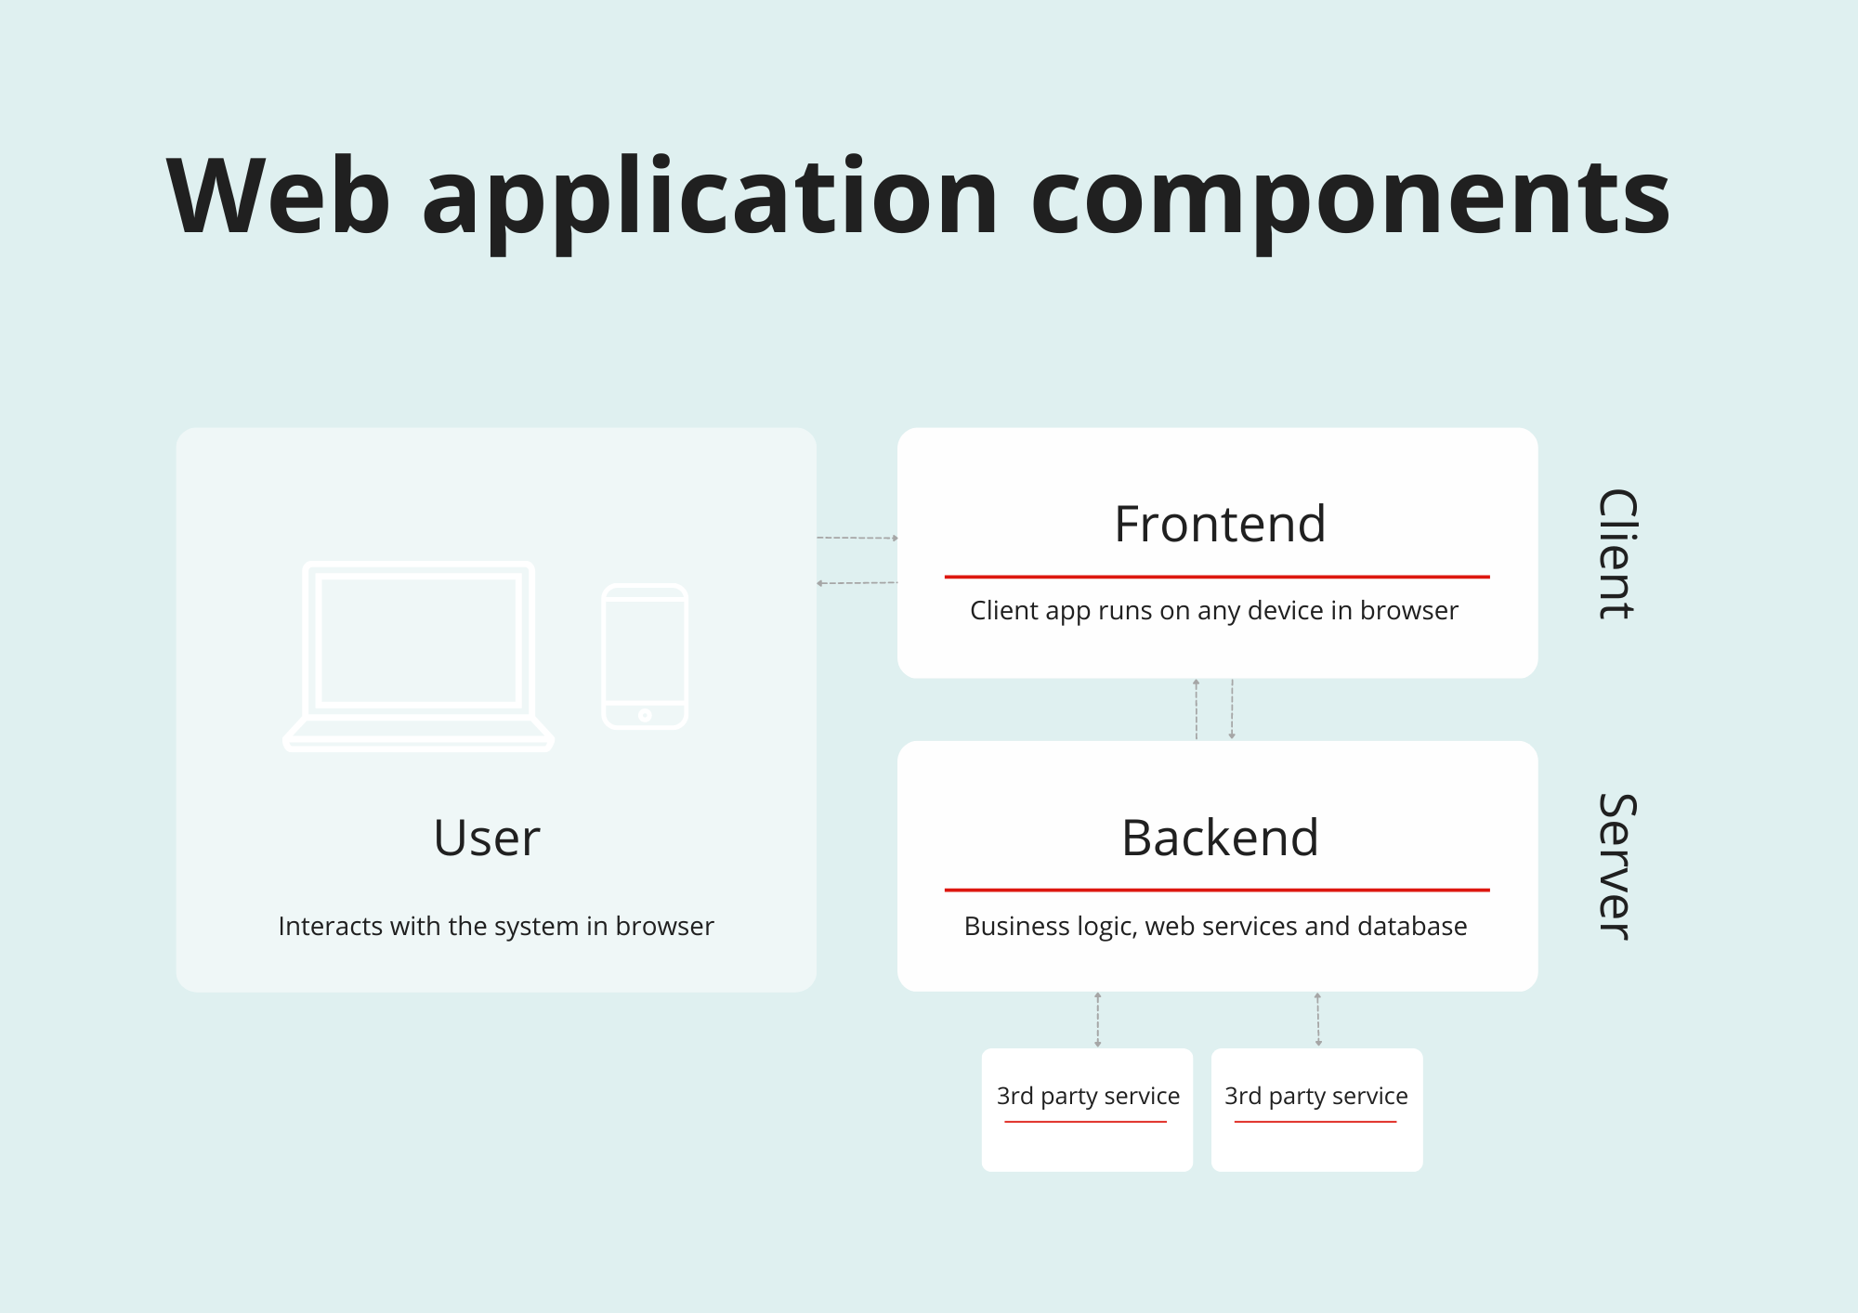
Data Extraction – Web Application
DOM
(Document Object Model)
Parsing
APIs
API
(Application Programming Interface)
Scraping
Notes:
https://www.researchgate.net/figure/Text-mining-process-and-techniques_fig1_340830772
Apply for spelling-based languages

Slide 26
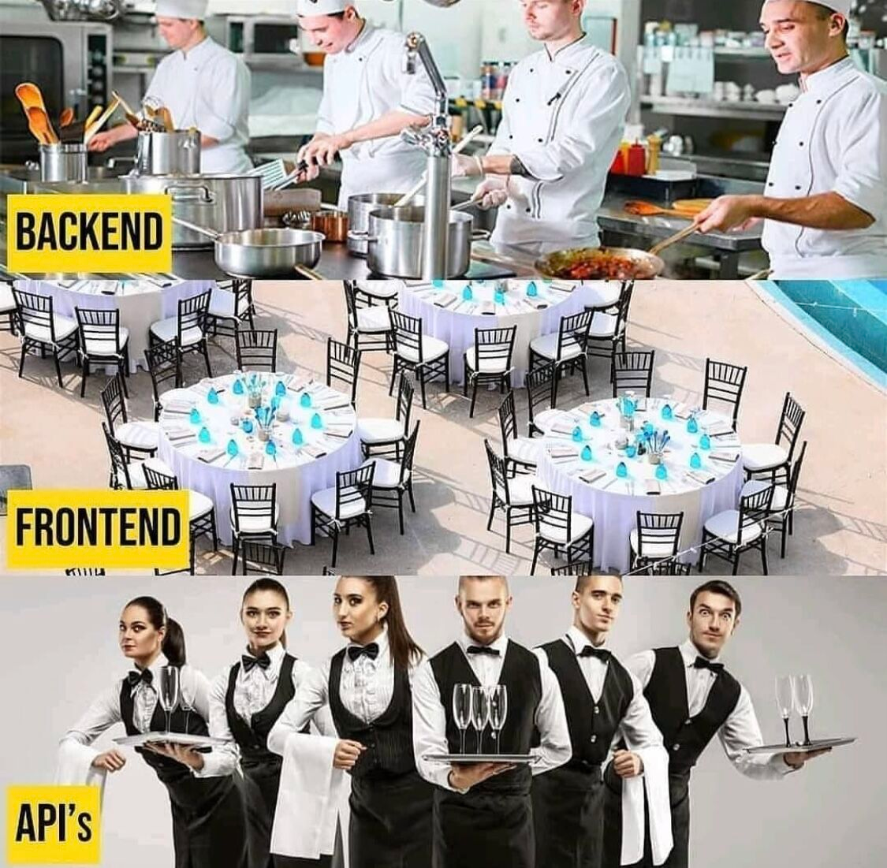
Data Extraction – Web Application
Notes:
https://www.researchgate.net/figure/Text-mining-process-and-techniques_fig1_340830772
Apply for spelling-based languages

Slide 27
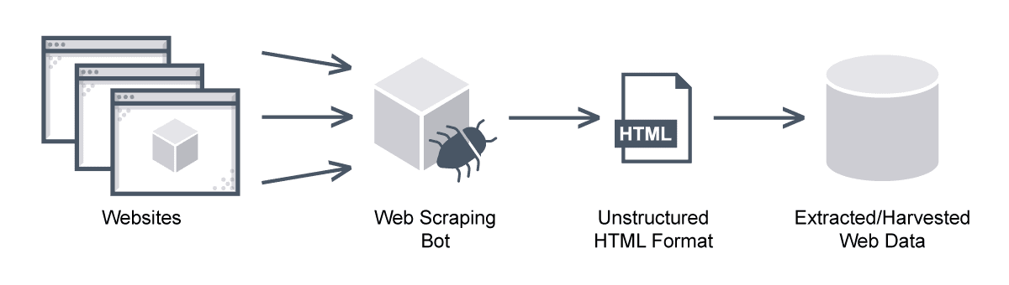
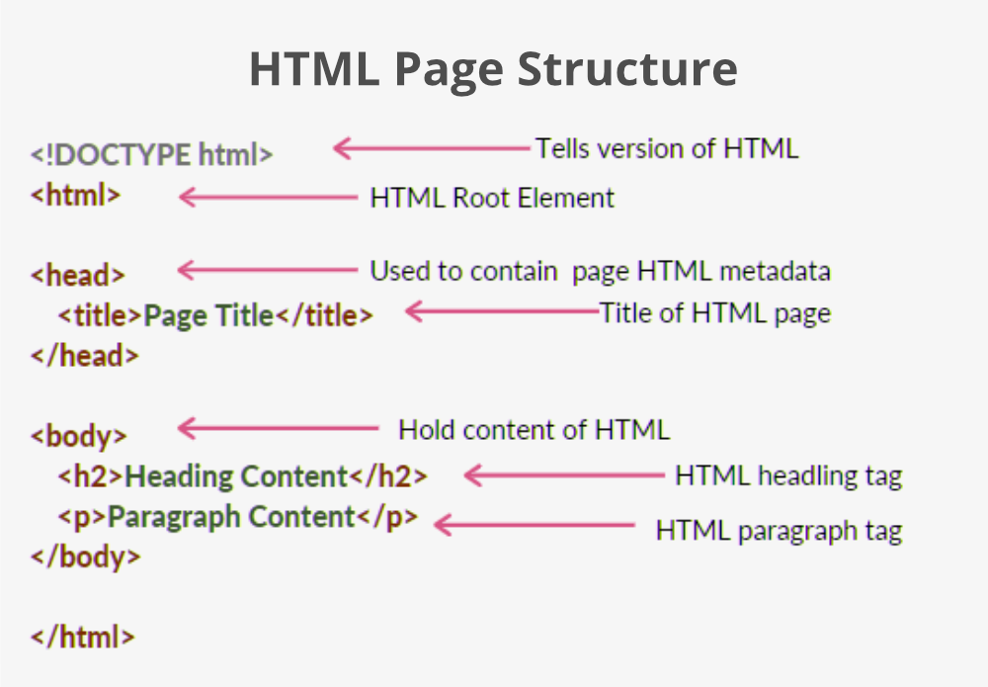
Web Scraping - DOM Parsing
Notes:
https://www.researchgate.net/figure/Text-mining-process-and-techniques_fig1_340830772
Apply for spelling-based languages

Slide 28
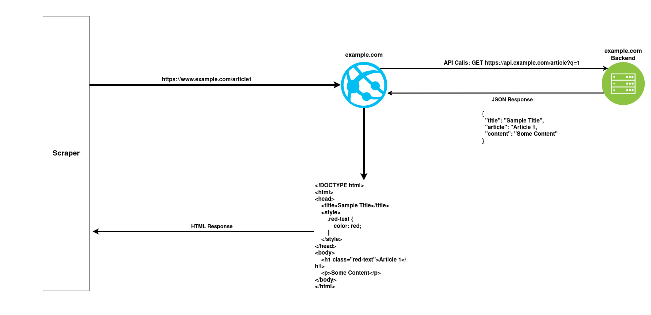
Web Scraping - DOM Parsing
Notes:
https://www.researchgate.net/figure/Text-mining-process-and-techniques_fig1_340830772
Apply for spelling-based languages

Slide 29
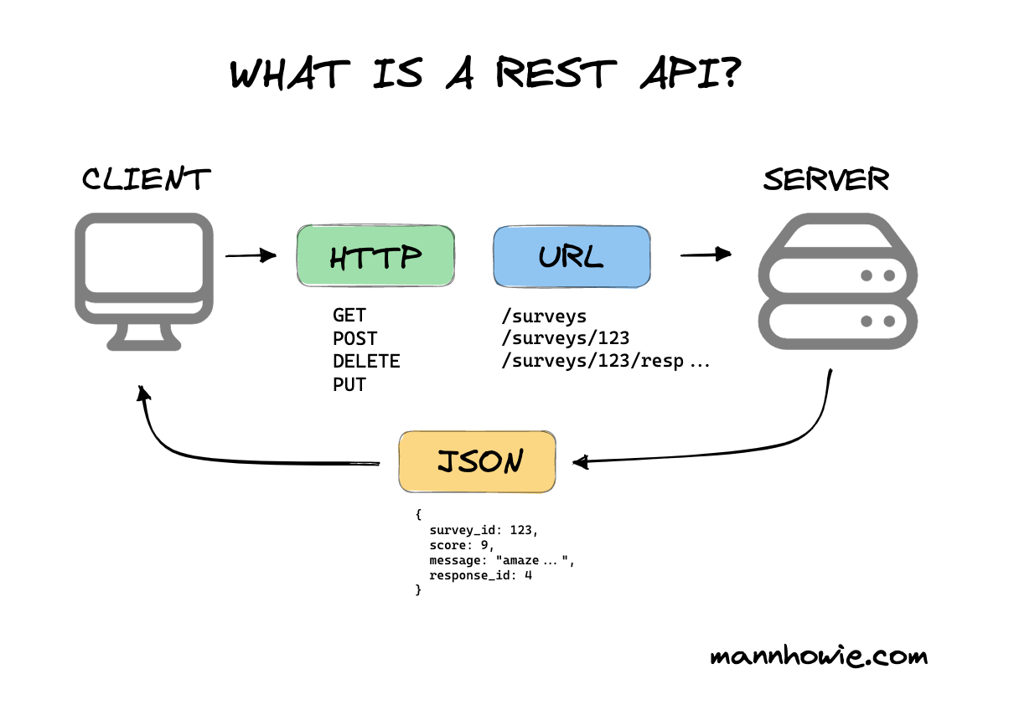
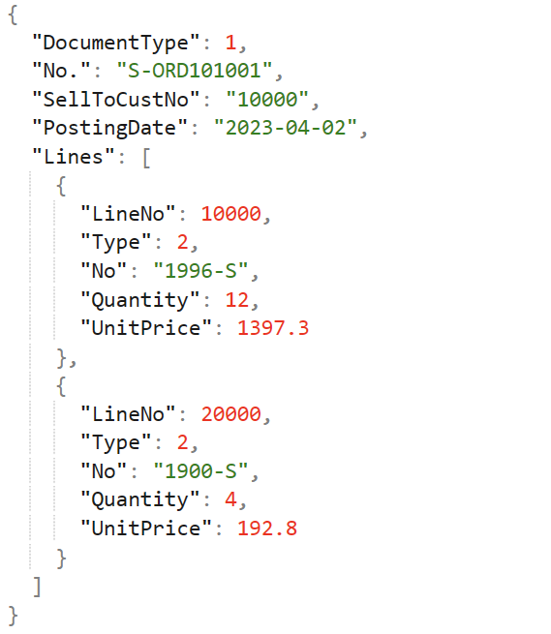
Web Scraping – API Scraping
Notes:
https://www.researchgate.net/figure/Text-mining-process-and-techniques_fig1_340830772
Apply for spelling-based languages

Slide 30
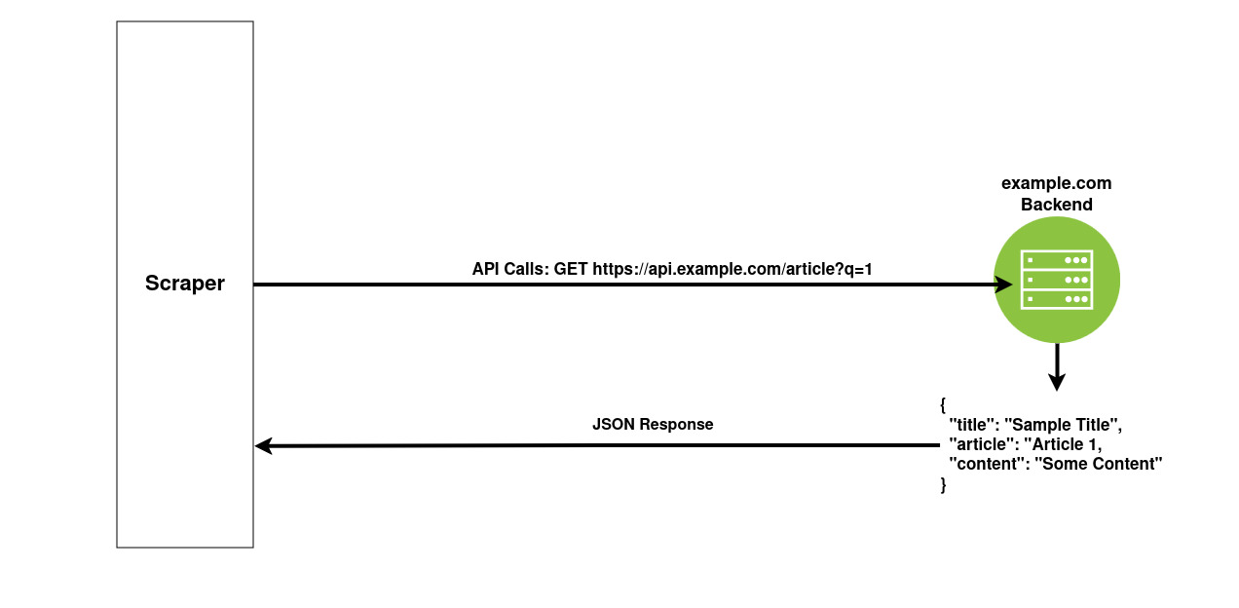
Web Scraping - API Scraping
Notes:
https://www.researchgate.net/figure/Text-mining-process-and-techniques_fig1_340830772
Apply for spelling-based languages

Slide 31
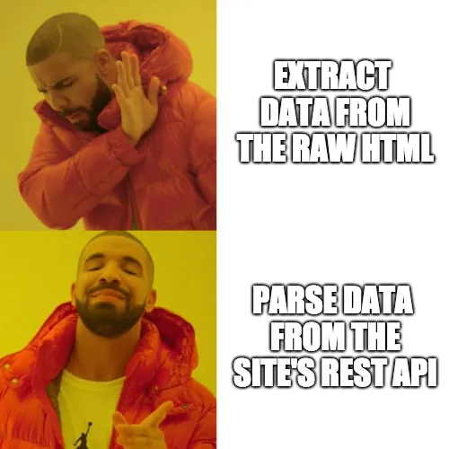
Summary
 | DOM Parsing | API Scraping
Format | Unstructured | Structured
Processing Cost | High Results mixed with irrelevant information | Low
Stability | Prone to changes | Relatively static
Availability | Always | Close sourced or paid
Notes:
https://www.researchgate.net/figure/Text-mining-process-and-techniques_fig1_340830772
Apply for spelling-based languages

Slide 32

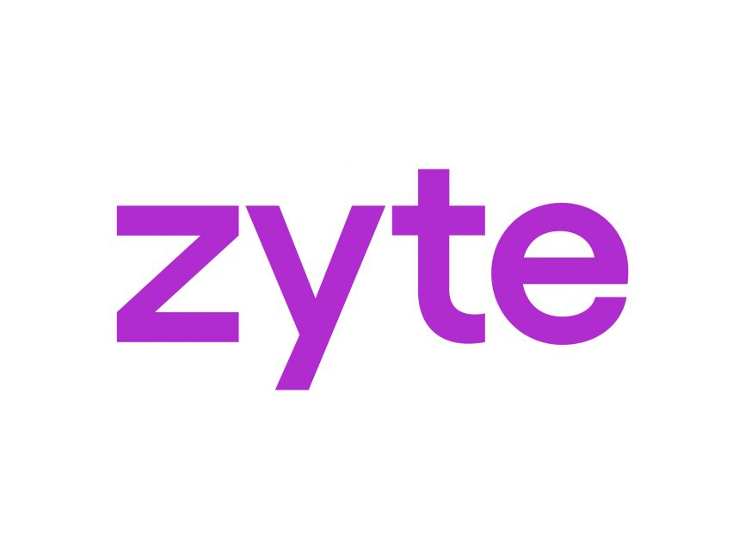








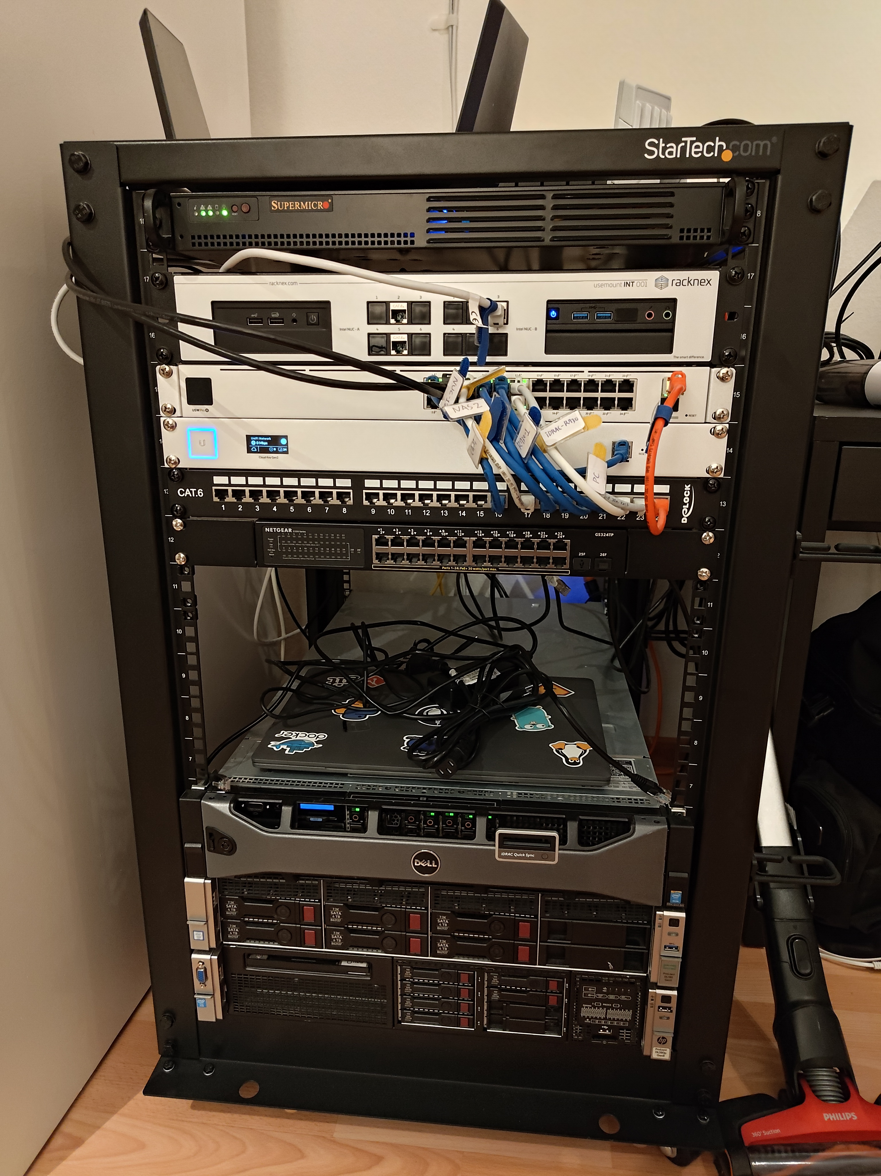
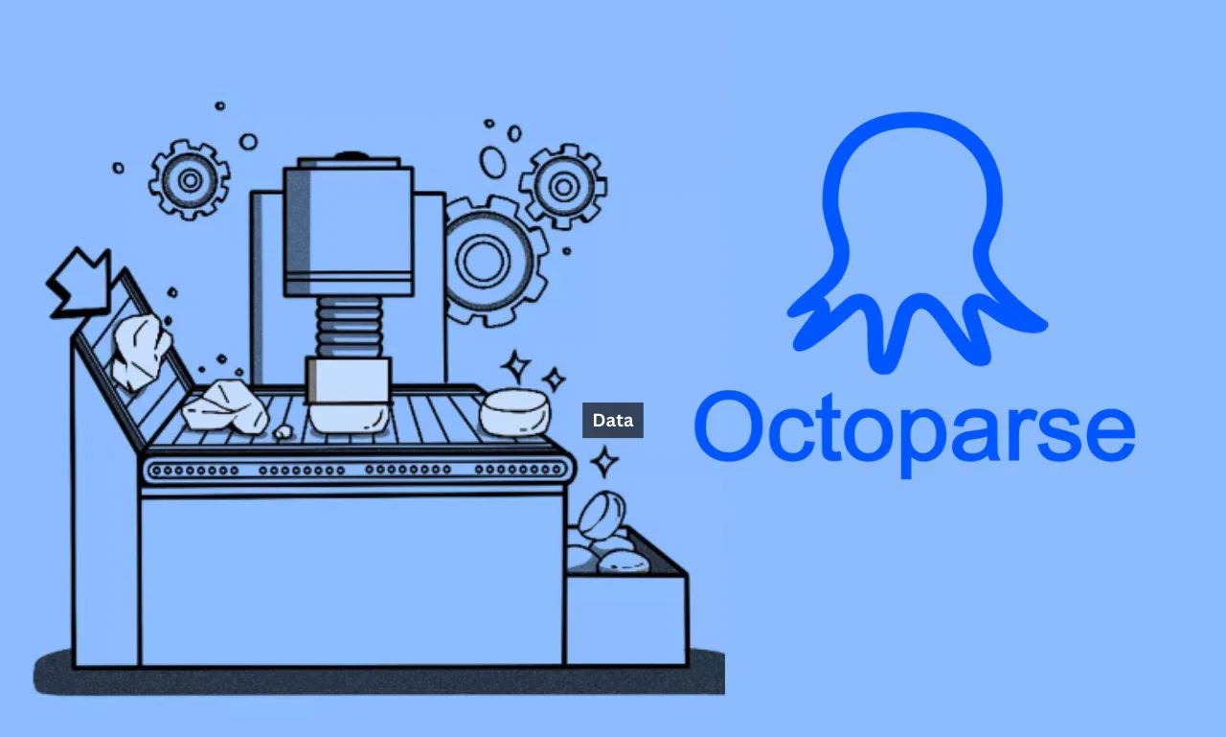
Available Tools
Roll Your Own
Custom Tooling
https://github.com/search?q=scarping&type=repositories
https://github.com/topics/web-scraper
https://scraper.algo7.tools
Notes:
https://www.researchgate.net/figure/Text-mining-process-and-techniques_fig1_340830772
Apply for spelling-based languages

Slide 33
Let’s Code

Slide 34
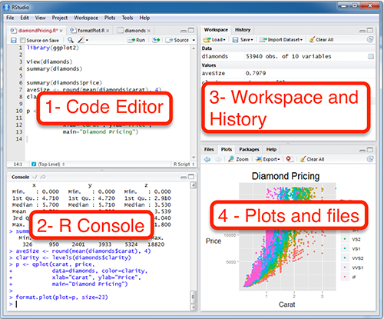
RStudio
Notes:
https://itueconomics.github.io/bil113e/r-week1.html

Slide 35
Thank You

